Slide 1
Applied Machine Learning
By Dr. Ali Saeed

Slide 2
Flask
Flask is use to implement Web based applications
It is lightweight, flexible, and easy to use for small to medium web applications

Slide 3

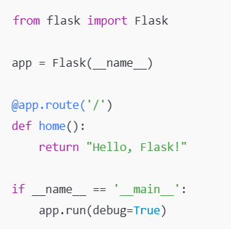

Flask – First Hello-World Application in Flask

Slide 4


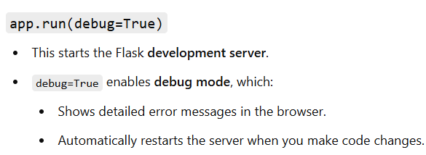

Flask Application Detail

Slide 5


Routing

Slide 6
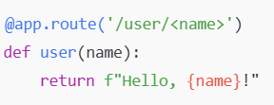
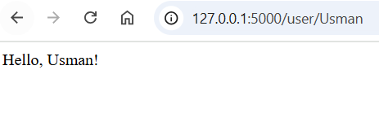
Pass a variable in the URL

Slide 7


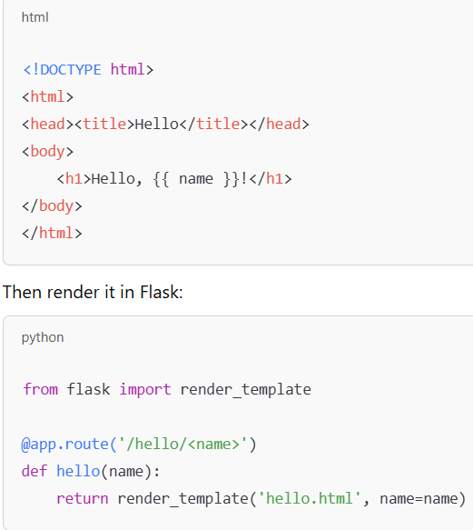
Templates in Flask

Slide 8
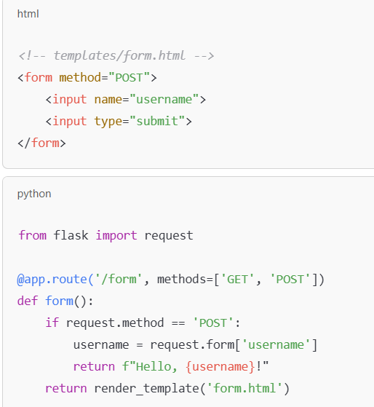
Forms and POST Requests

Slide 9
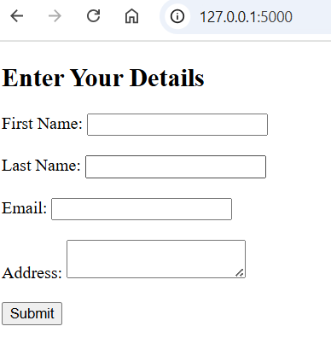
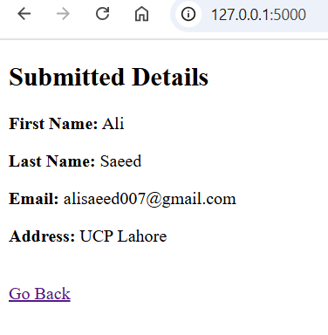
Application in Flask

Slide 10
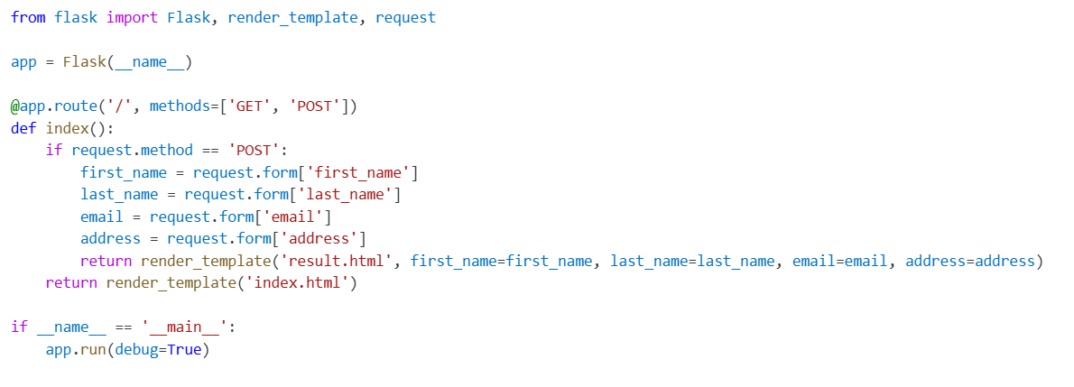
Python-Code

Slide 11
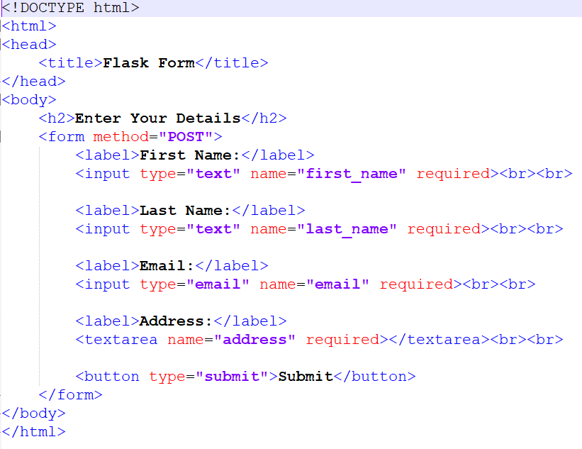
Index.html

Slide 12
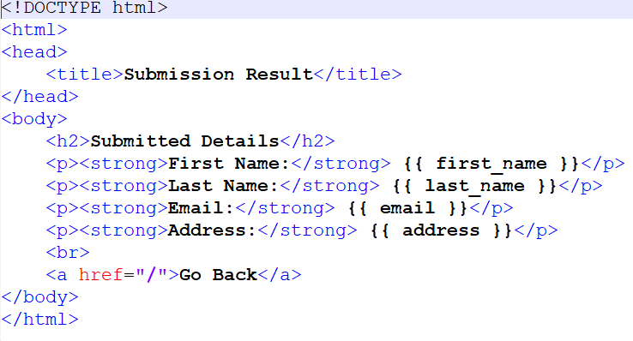
Result.html

